Slide 1

Capstone Project – I: Review – 2 On
Enhance the security and privacy of Federated Learning systems
Presented by the Batch No. : CSE-24
A.ANITHA BU22CSEN0101001 (TL)
V.NIRANJAN BU22CSEN0101209
G.B.NAMITHA BU22CSEN0100875
C.PURUSHOTHAM SAI BU22CSEN0100356
Under the Guidance of
Parikshith Nayak S K
Assistant professor
Department of Computer Science and Engineering
GITAM School of CSE, GITAM (Deemed to be University),
Bengaluru, Karnataka, INDIA.

Slide 2
CONTENTS
Recap of Capstone Project Introduction Review-1
  Problem Statement
  Objectives
  Feedback from Guide/Reviewers and actions taken after Review–1
Requirement Analysis
Identification of tools/technology/algorithms
Design Strategy (project workflow/ system design/ DFD/UML design)
Conclusion
References

Slide 3
Problem Statement
This project improves the security and privacy of Federated Learning (FL). In FL, clients train on their own data, but the updates they send to the server can still leak information or be attacked. To fix this, we use AES encryption and digital signatures so that updates are protected during transmission and only trusted clients can contribute. Using a federated logistic regression model, we show that secure updates make the global model more reliable and safe. This approach is useful for privacy-sensitive areas like healthcare, finance, and IoT.

Slide 4
Objectives
To ensure data privacy by preventing direct sharing of client data during model training.
To integrate security mechanisms like AES encryption, differential privacy, and secure aggregation.
To protect user identity and sensitive information from inference and reconstruction attacks.
To enhance model reliability and integrity through secure communication and update validation.
To build a scalable and trustworthy federated framework that aligns with data protection standards.

Slide 5
Feedback from Guide/Reviewers and actions taken after Review–1
Feedback from Guide/Reviewers
1. The encryption methods are not explained properly.
2. The literature survey should include recent papers (after 2023).
Actions taken
1. Revised and clearly explained encryption techniques such asAES Encryption and Digital to match the presentation content.
2. Updated the literature survey with the latest research papers from 2023 and 2024 related to secure and privacy-preserving federated learning.

Slide 6
Requirement Analysis
Hardware Requirements:
Processor : Intel Core i5 / AMD Ryzen 5
RAM : Minimum 8 GB
Storage : 256 GB
GPU : NVIDIA GTX 1050
Software Requirements:
Operating System : Windows 10/ Ubuntu 22.04 LTS, Python
Libraries/Frameworks :TensorFlow Federated,Pytorch,Numpy,Pandas.
Security Tools :PyCryptodome / Cryptography library
IDE / Editor :Jupyter Notebook / VS code / PyCharm.
Version Control – Git/GitHub

Slide 7
Identification of tools/technology/algorithms
TOOLS:
Python 3.10+:Main language for building and running the project.
TensorFlow Federated (TFF): Framework for simulating and managing the Federated Learning process across multiple clients.
PyCryptodome: Provides encryption and digital signature support for security..
Flask: Used as the backend to connect clients and server securely.
MySQL: Database used to store client details, model parameters, encryption keys, and update logs.
GitHub: Version control platform for collaborative development, code storage, and project management.

Slide 8
Identification of tools/technology/algorithms
Technologies:
Federated Learning (FL): Enables decentralized model training without sharing raw data, ensuring user privacy.
Encryption Techniques (AES): Protects data during transfer between clients and server.
Digital Signatures: Ensures authenticity and integrity of model updates from trusted clients.
Secure Aggregation Protocol: Combines client updates safely without exposing individual data.
RESTful APIs: Allows smooth and secure communication between server and clients.

Slide 9
Identification of tools/technology/algorithms
Algorithms:
Federated Averaging (FedAvg): Aggregates local model updates from clients to form a global model without sharing raw data.
Advanced Encryption Standard (AES): Encrypts model parameters to ensure secure and confidential data transmission.
Digital Signature Algorithm (DSA): Verifies the authenticity and integrity of model updates before aggregation.
Secure Aggregation Algorithm: Server aggregates multiple encrypted updates such that it cannot see any client's individual update.
Differential Privacy Algorithm : Add controlled noise to updates before sending so it prevent attackers from reconstructing the users actual data.

Slide 10
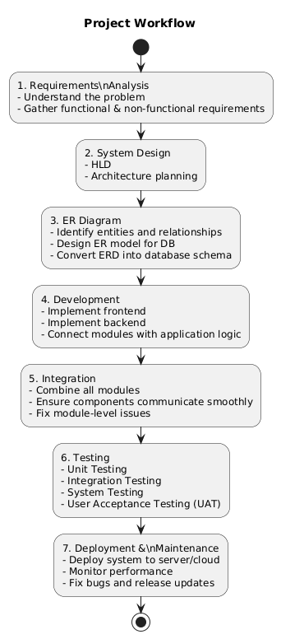
Design Strategy
Project Workflow

Slide 11
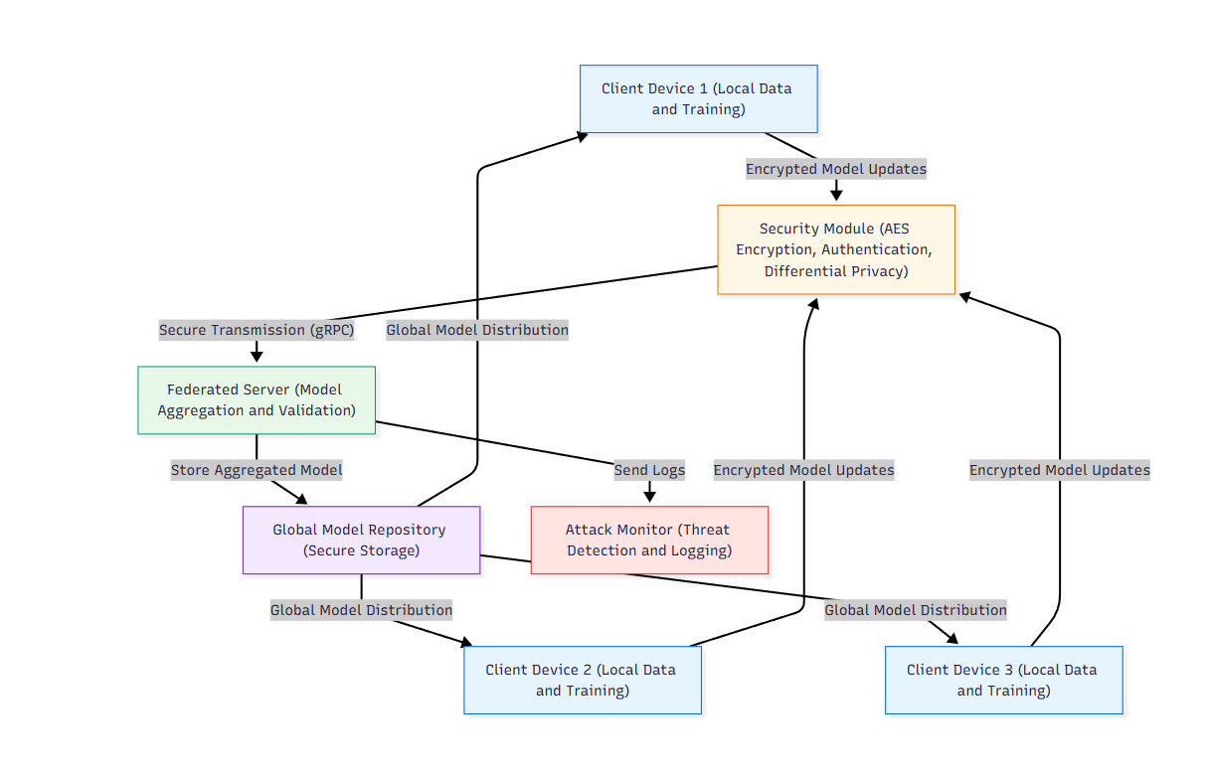
Design Strategy
System Design

Slide 12
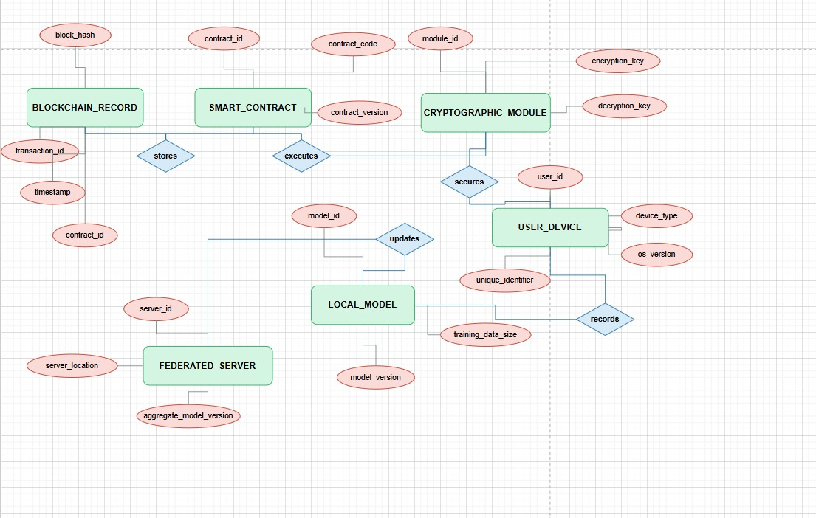
Design Strategy
ER Diagram

Slide 13
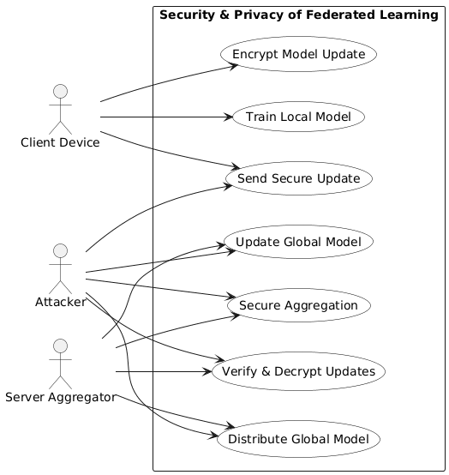
Design Strategy
USE CASE DIAGRAM

Slide 14
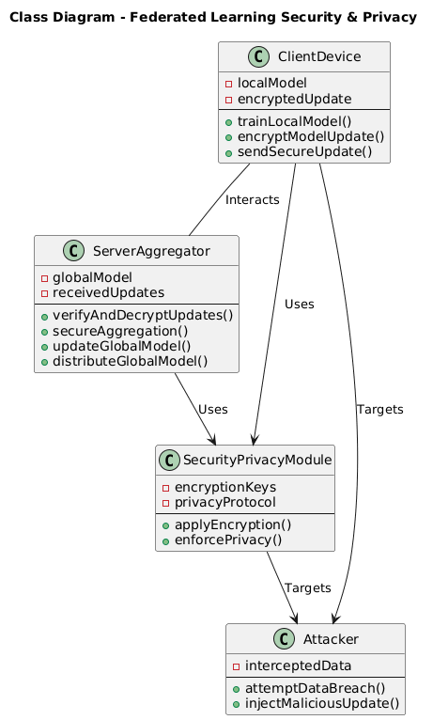
Design Strategy
CLASS DIAGRAM

Slide 15
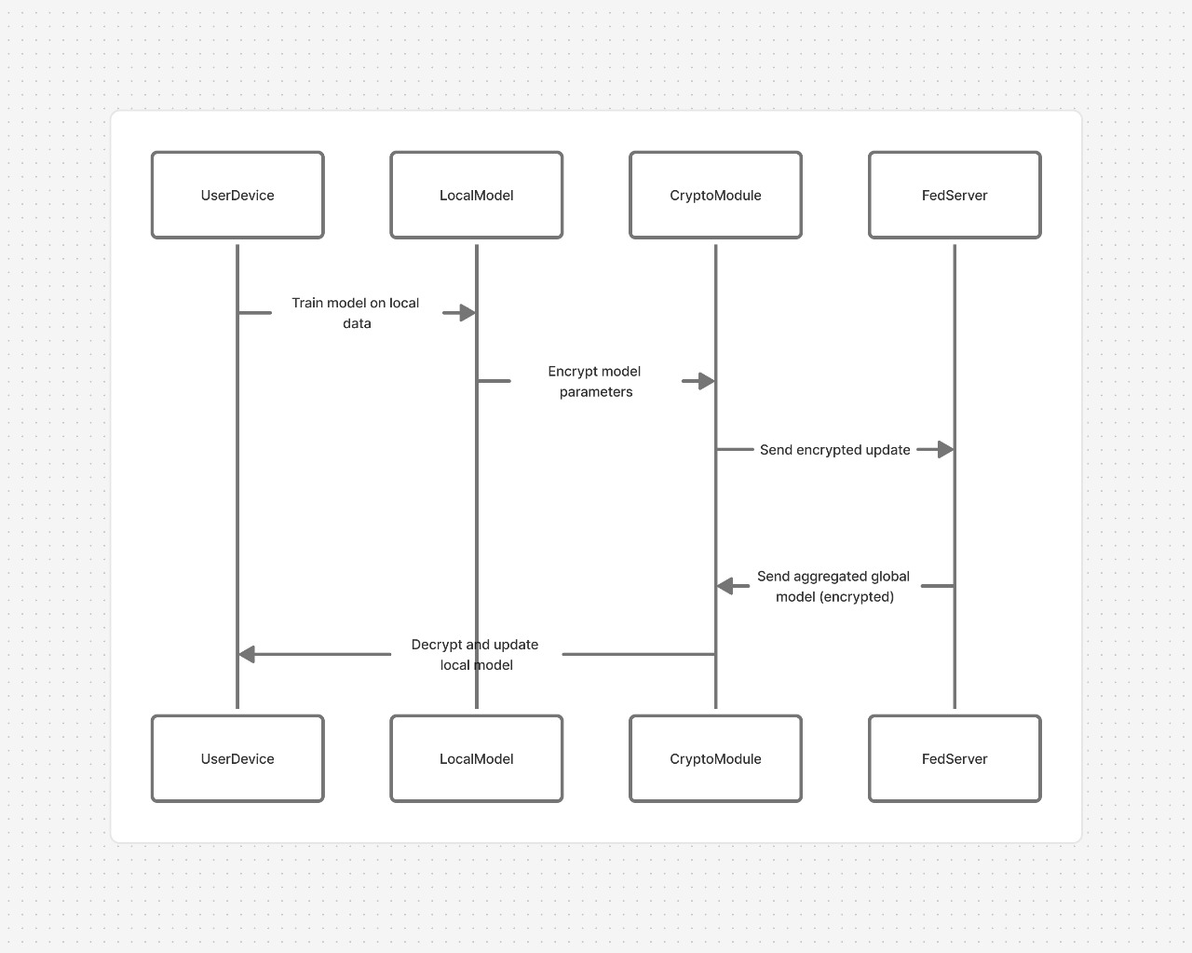
Design Strategy
SEQUENCE DIAGRAM

Slide 16
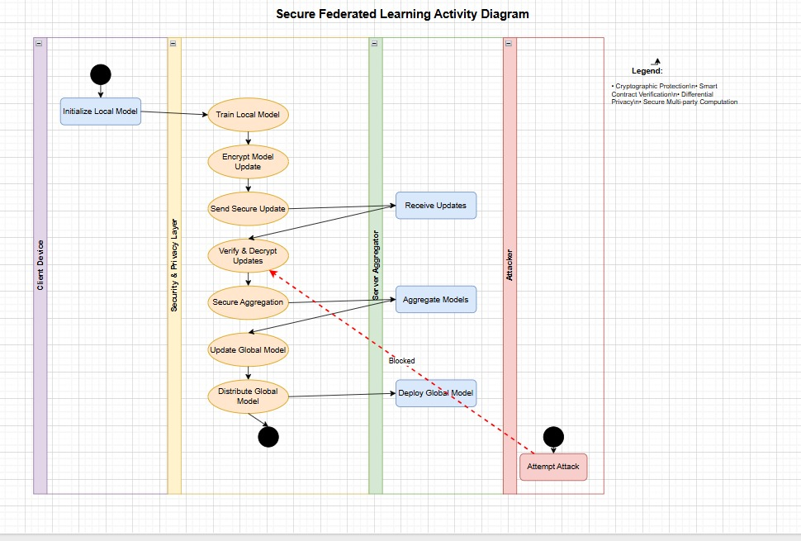
Design Strategy
ACTIVITY DIAGRAM

Slide 17
Conclusion
Enhancing the security and privacy of Federated Learning is essential to ensure trustworthy and ethical AI collaboration. By integrating techniques such as secure aggregation, differential privacy, homomorphic encryption, and trusted execution environments, sensitive user data can remain protected while still contributing to global model improvement. Robust authentication, encryption key management, and continuous auditing further strengthen the framework against potential threats.Ultimately, secure and privacy-preserving Federated Learning promotes data confidentiality, system integrity, and user trust, enabling organizations to leverage distributed data responsibly and in compliance with data protection regulations.

Slide 18
References
[1] Cui, L., Qu, Y., Xie, G., Zeng, D., Li, R., Shen, S., & Yu, S. (2021). Security and privacy-enhanced federated learning for anomaly detection in IoT infrastructures. IEEE Transactions on Industrial Informatics, 18(5), 3492-3500
[2] Ullah, F., Nadeem, M., Abrar, M., Amin, F., Salam, A., & Khan, S. (2023). Enhancing Brain Tumor Segmentation Accuracy through Scalable Federated Learning with Advanced Data Privacy and Security Measures. Mathematics, 11(19), 4189. https://doi.org/10.3390/math11194189.
[3] Zhu, L., Hu, S., Zhu, X., Meng, C., & Huang, M. (2023). Enhancing the security and privacy in the IoT supply chain using blockchain and federated learning with trusted execution environment. Mathematics, 11(17), 3759.
[4] Alazab, A., Khraisat, A., Singh, S., & Jan, T. (2023). Enhancing privacy-preserving intrusion detection through federated learning. Electronics, 12(16), 3382.

